Slide 1
Presentation Inventory And Billing system
Presenter:
Name: Mahjbin
Roll-no: 035
Section: A

Slide 2
Content
Table Of Content:
Project Purpose
Key – Features
Working Diagrams
Steps of Flow

Slide 3
Project Purpose
This project is aimed at developing a desktop based application, Inventory Management system for managing the inventory and generating bills of your shops, stores, office stocks and many more…. The System can be used to store details of each individual item such as name, quantity, serial-number, price…….

Slide 4
Key-Features
Stores infinite number of Products
Provides login Security
Saves new User login
Saves data On Pc
Generates Bill
Save’s Data in an Organised Excel Sheet with press of Button

Slide 5
Concepts And Techniques:
Dynamic Arrays
Classes
Copy – Constructors
Pointers
File Handling and many more…
Functions

Slide 6
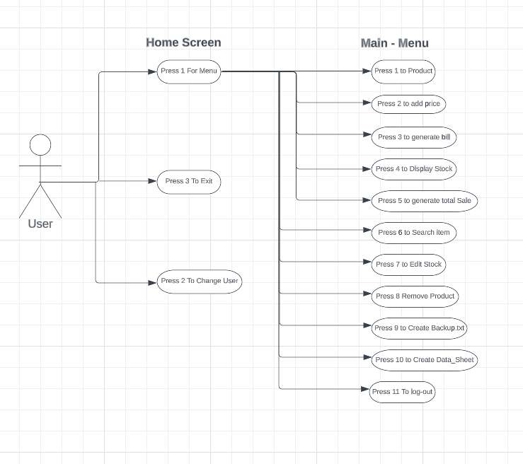
Use Case Diagram (How user Interacts with our Program)

Slide 7
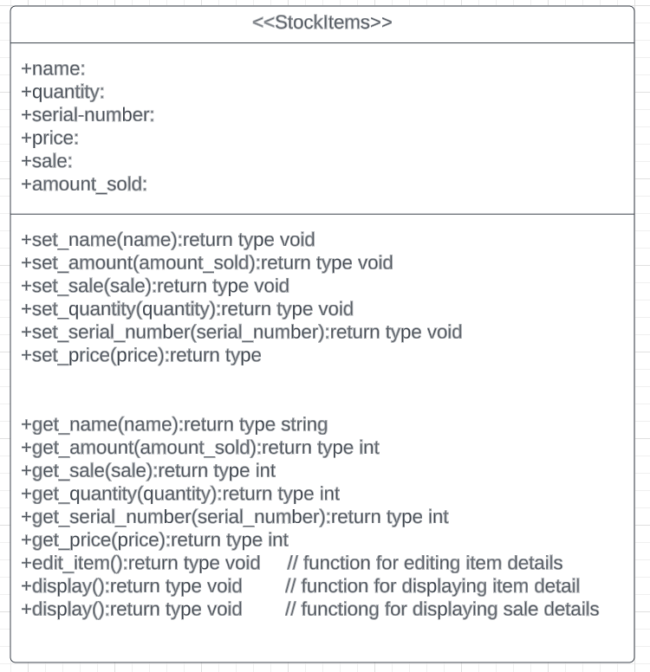
Class Diagram Image

Slide 8
Thank – You !
Allah Hafiz !
Have a Blessed Life…..

